Slide 1
Project Specification COMO On Prem/Azure

Slide 2
COMO On-Prem
COMO stands for COnverged MOnitoring.
This is an Open Source Monitoring Platform for Organisation COMO is based on ELK (a free Open Source monitoring stack) for the logs and Prometheus/Cortex/Grafana for the metrics it collects and stores applications' metrics and displays dashboards.
This existing infrastructure was designed to replace legacy K8sv2 based Monitoring platform called STML.
Total More than 120 application across Organisation

Slide 3

Usability of Monitoring infrastructure

Slide 4
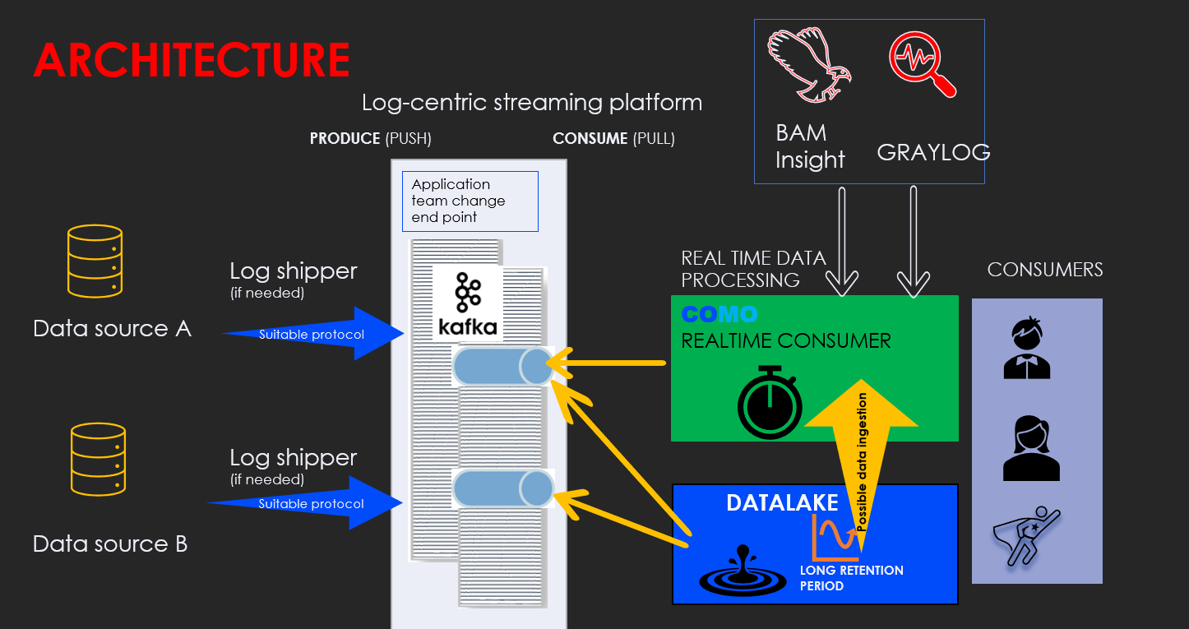
Architecture

Slide 5
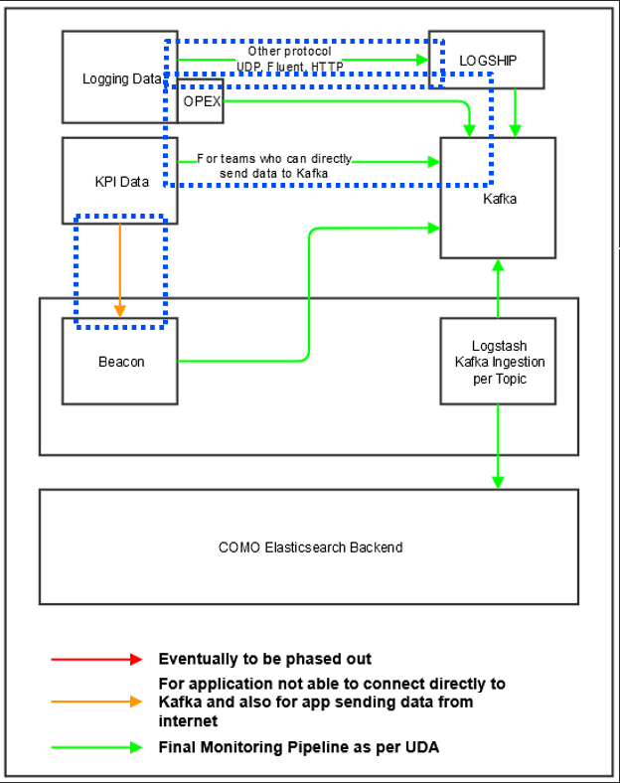
General Flow of data across components.

Slide 6
COMO On-Prem Components
Application Team
Opex Appender
MDW Kafka topics
COMO Logstash
Elasticsearch Index
Grafana/Kibana

Slide 7
Ansible Operations on COMO
Use Cases
Update cluster configuration
Setting up a new node
Node recycling
Clearing / Maintaining FS

Slide 8
COMO Azure

